Slide 1
CLIMATE CHANGE
Geon Kim, Elia Morhej and Brandon Nguyen

Slide 2
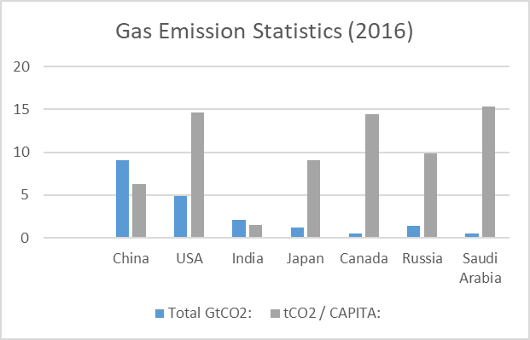
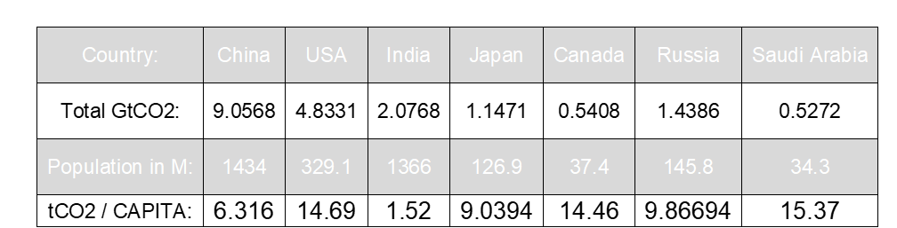
First table and chart
Total GtCO2: 7 different countries’ total billion tons of CO2 emissions in 2016 and their population count in 2016.
tCO2/CAPITA: uses a formula to display the tons of CO2 emissions per person in that country (per capita).
Chart: visualizes which country’s emission problems are on an individual level and which are not.

Slide 3
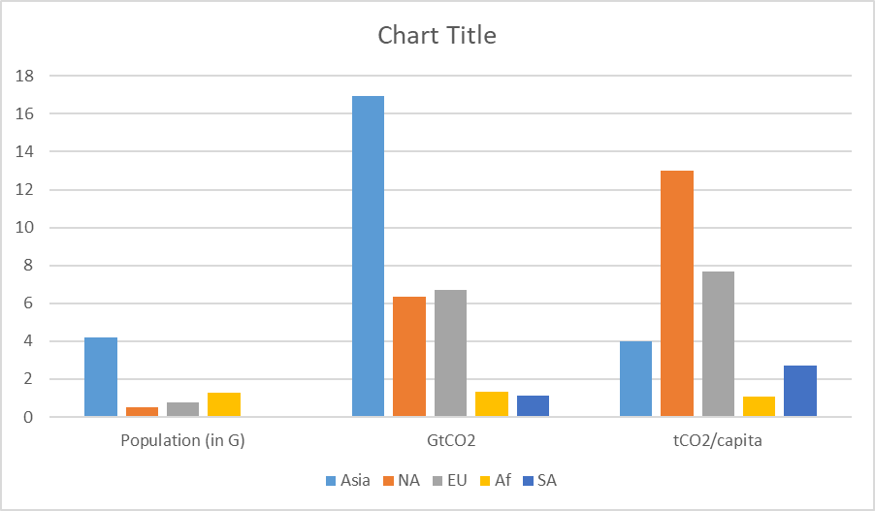
Second table and chart
Total population per continent
Emissions of CO2 per continent
The percentage of total worldwide emissions, all during the year of 2017
The average amount of CO2 emissions per person for each continent

Slide 4
ETHICS
Question: Has reducing gas emissions become a worldwide responsibility for everyone despite it not affecting everyone equally?
Stakeholders: People indirectly affected (IDR), People directly affected (DR), Government, Companies
IDR: Effort and time to adapt to a new lifestyle (loss)
Government: Reduced funding for other sectors (loss) / Gains more taxes (gain)
DR: Mental and physical health (loss) / Get more support/help from organizations (gain)
Duties
IDR: a moral duty to help those in need
Government: research to facilitate being ecological for the people
Companies: use more renewable energy options for their industrial needs
Consequentialism: the world will overall be a better place for absolutely everyone if everyone truly sees taking care of the environment as a responsibility.
Deontology: you have a duty as a citizen of the Earth to take care of the environment for your sake and for others.

Slide 5
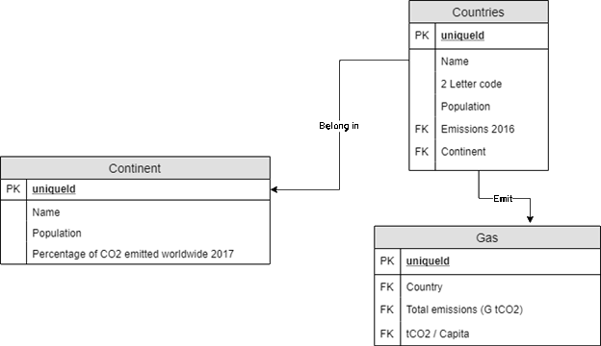
ER Diagram

